Slide 1
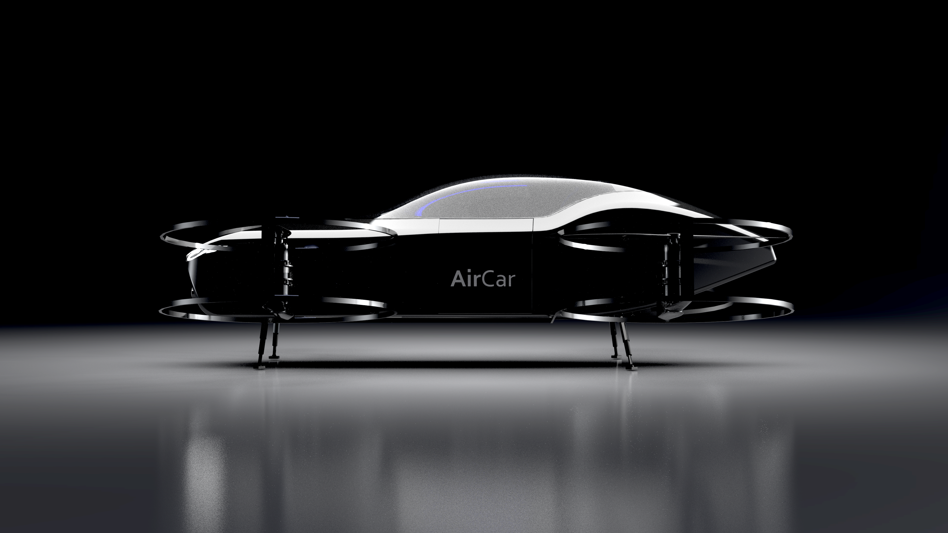

Autonomous all-electric human carrying flying car
eray@aircarcorp.com

Slide 2
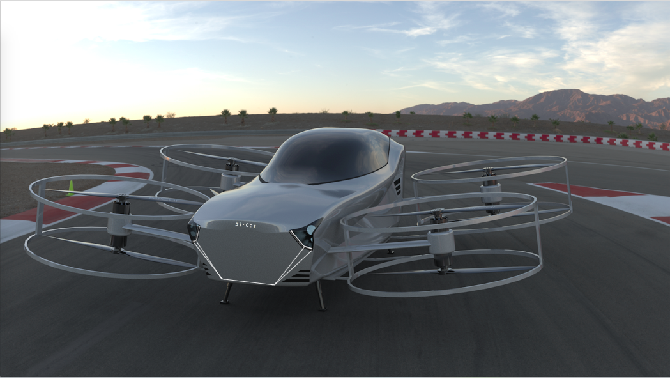
Range > 70 km (42 Miles)
Top speed >120 km/h (75 Mph)
Passenger Capacity: 2
Charging time 80% in < 15 min
Lift Capacity > 500 kg
Power > 400 kW (> 530 hp)
Intelligent, autonomous, all-electric flying car

Slide 3
Market Size
228
million people
Over $1M wealth
28,500
Global super luxury car sales per year
(Rolls-Royce, Bentley, Aston Martin etc.)
1000
AirCar sales in five years
($200M revenue)
Broad Market
Specific Market
Target

Slide 4
Business Model
Unit Cost Metrics
Cost of AirCar Materials: $11,500
Cost of AirCar Labor: $4,000
Total Unit AirCar Cost: $15,500
Estimated AirCar Sale Price: $200,000
Use Cases
1) Air Cargo Transportation
2) Fire Fighter Rescue Drone
3) Air Ambulance
4) Military Service
5) On-Demand Urban Air Transportation
Estimated AirCar Delivery: 1000 Units
(2018-2023)
Revenue Expectation: $200M
(2018-2023)

Slide 5
Timeline
 | 2017 |  |  | 2018 |  |  |  | 2019 |  |  |  | 2020 |  |  |  | 2021 |  |  |  | 2022
Phase | Q2 | Q3 | Q4 | Q1 | Q2 | Q3 | Q4 | Q1 | Q2 | Q3 | Q4 | Q1 | Q2 | Q3 | Q4 | Q1 | Q2 | Q3 | Q4 | Q1 | Q2 | Q3 | Q4
Initial Idea | ●
Research | ● | ●
Evaluation of Technology |  | ●
Design |  | ● | ● | ●
Suppliers Selection and Negotiations |  |  | ● | ●
Prototyping 1:4 Scale |  |  |  | u | u
Initial Funding |  |  |  |  | u | u
AI Software Development |  |  |  |  |  | Q | Q
Production of AirCar |  |  |  |  |  | Q | Q
Test Flights |  |  |  |  |  |  | Q | Q
Series A Funding |  |  |  |  |  |  | Q | Q
Licensing and Public Test Flights |  |  |  |  |  |  |  | Q | Q | Q
Series B Funding |  |  |  |  |  |  |  |  |  | Q | Q
Marketing |  |  |  |  |  |  |  |  |  |  | Q | Q | Q | Q | Q
Sales |  |  |  |  |  |  |  |  |  |  | Q | Q | Q | Q | Q | Q | Q | Q | Q | Q | Q | Q | Q
IPO |  |  |  |  |  |  |  |  |  |  |  |  |  |  |  |  |  |  |  | Q | Q | Q | Q
 |  |  |  |  |  |  |  |  | STATUS: |  |  | COMPLETED: |  |  | ● | PROGRESS: |  |  | u | PLANNED: |  |  | Q
 |  |  |  |  |  |  |  |  | VALUATION (Est.): |  |  |  | $5M: |  | u |  | $50M: |  | Q |  | $250M: |  | Q

Slide 6
Competitors

Slide 7
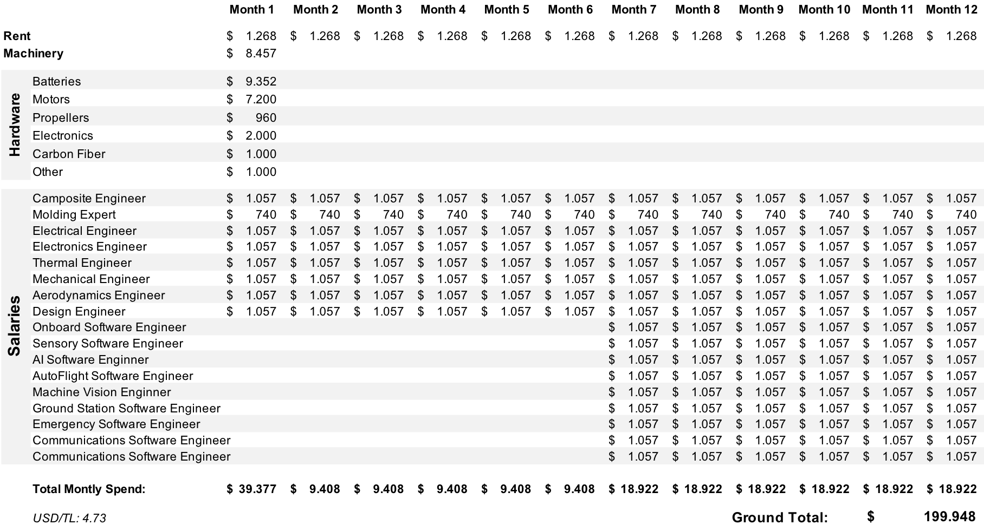
Raising $200,000 for making fully functional prototype at $5M valuation for:

Slide 8
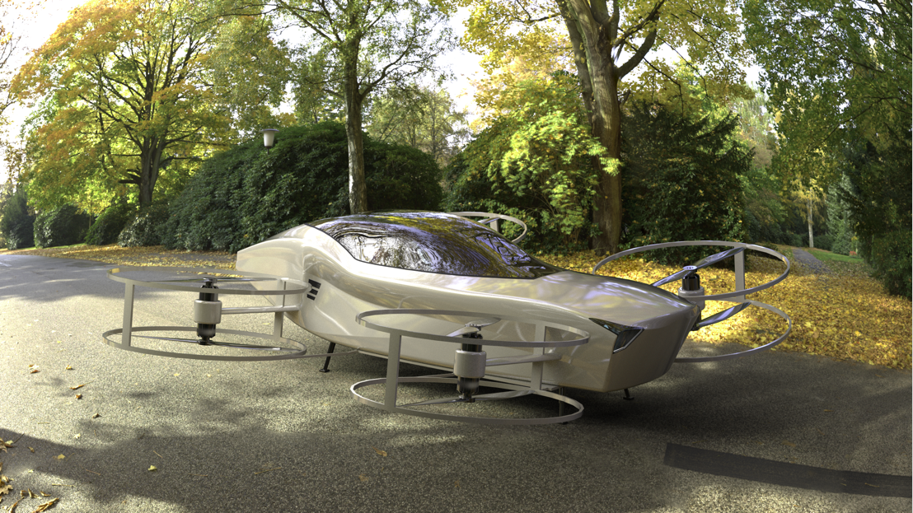

Slide 9
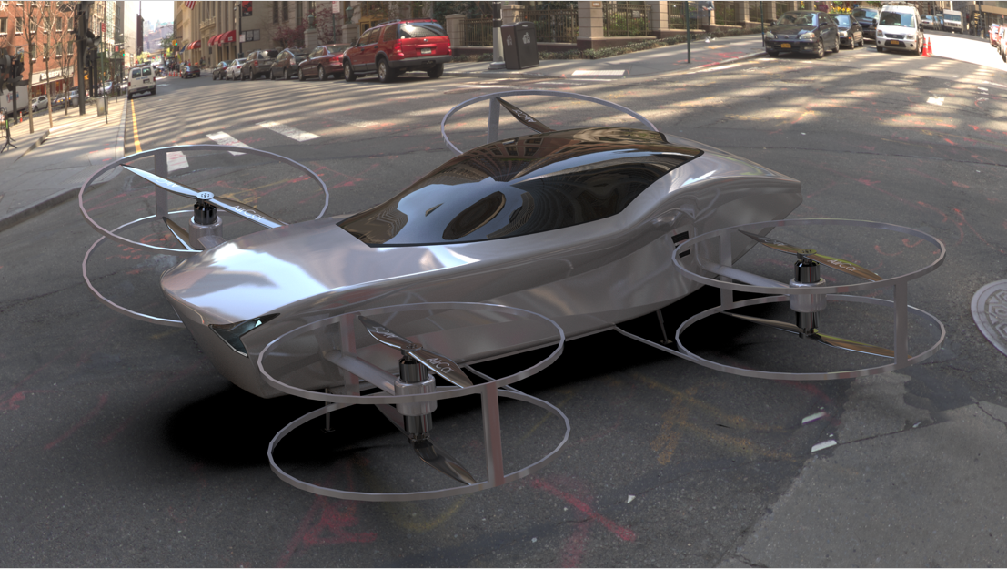

Slide 10
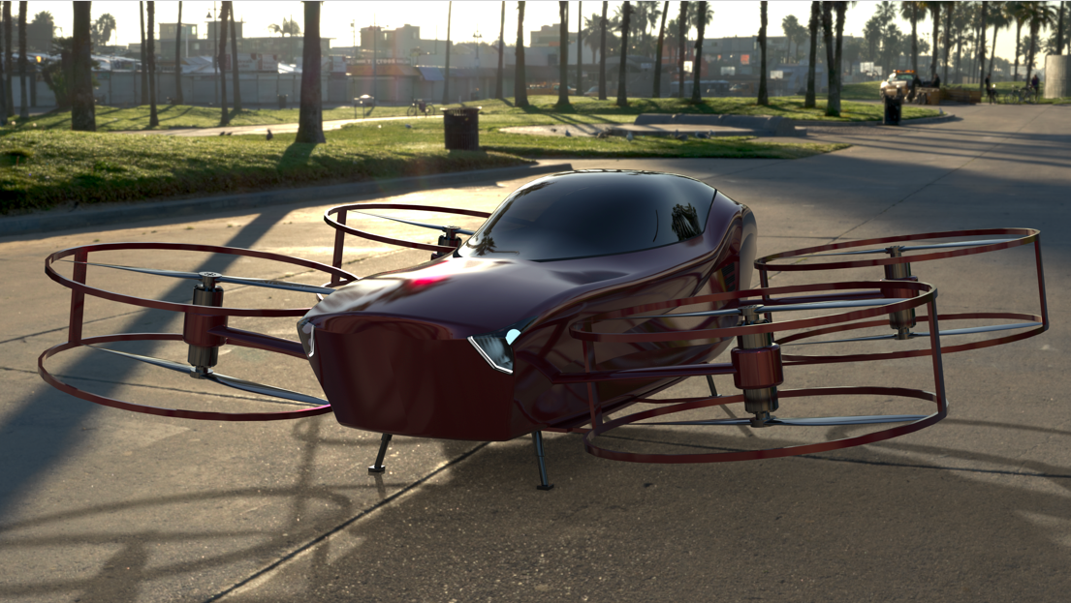

Slide 11
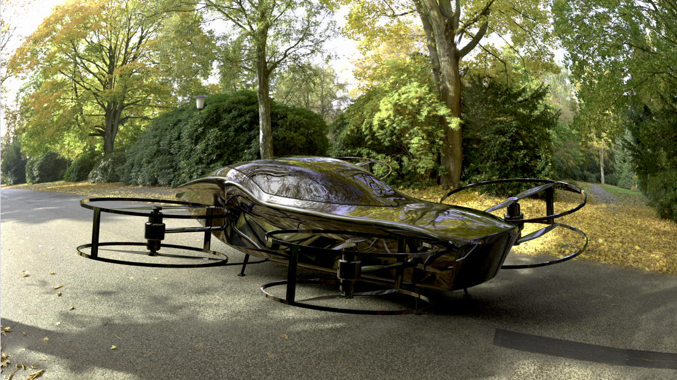

Slide 12
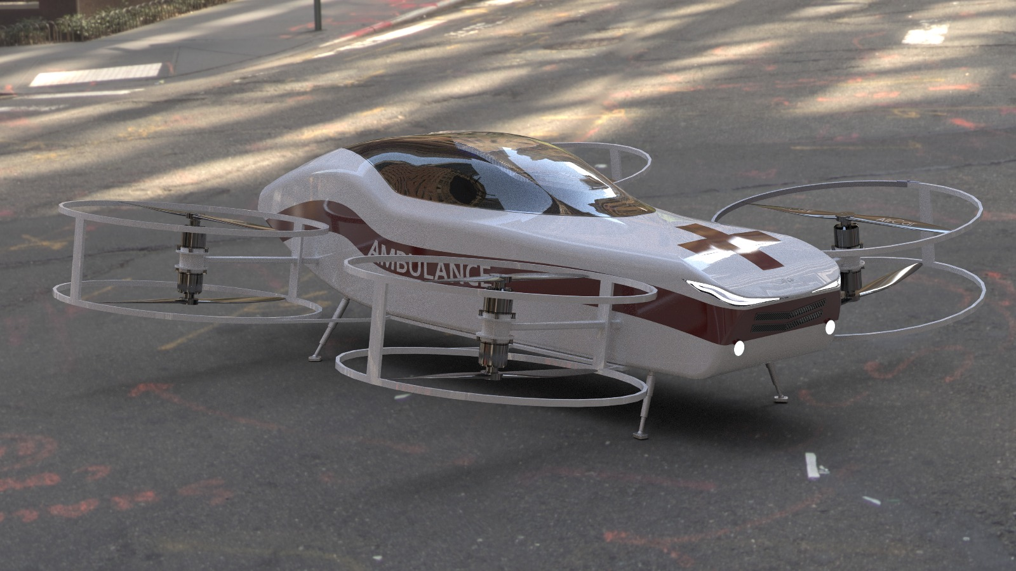
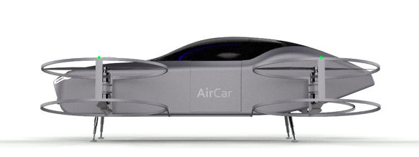
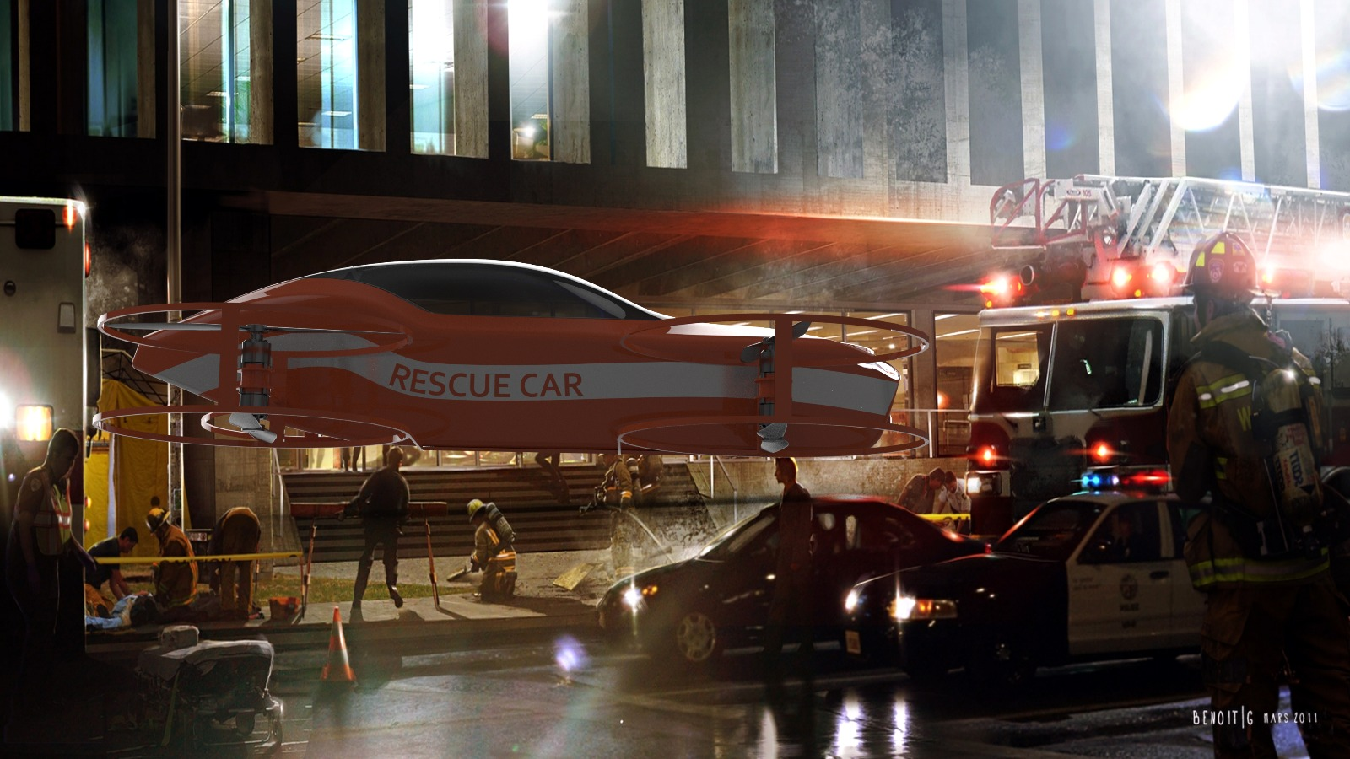
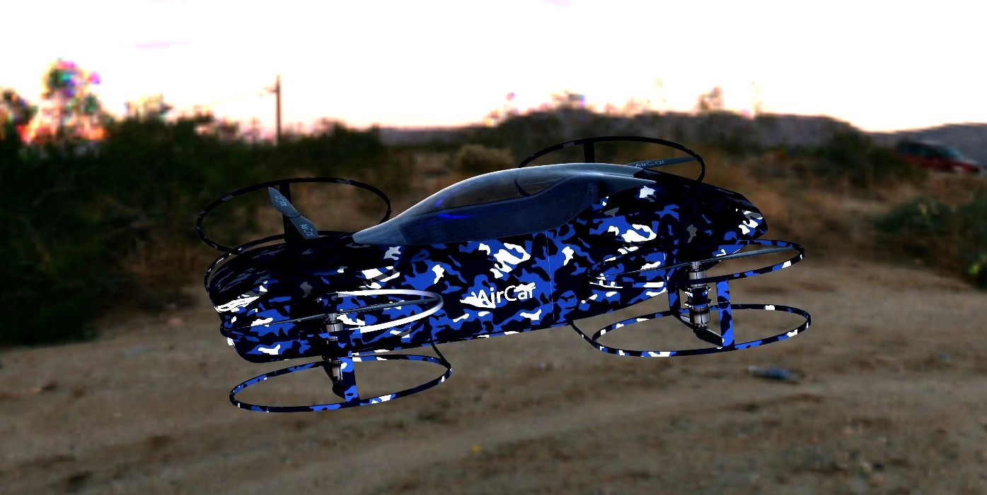
Ambulance, Cargo, Military, and Rescue Car

Slide 13
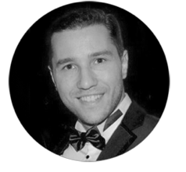
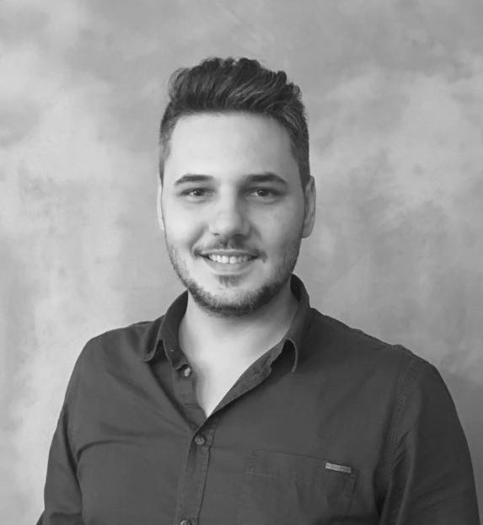


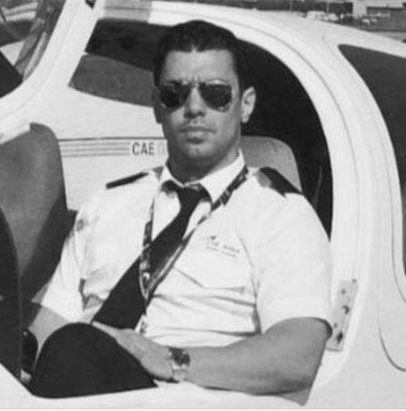

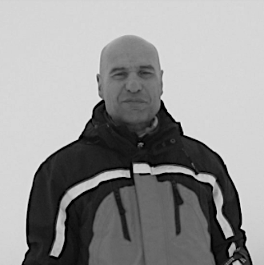
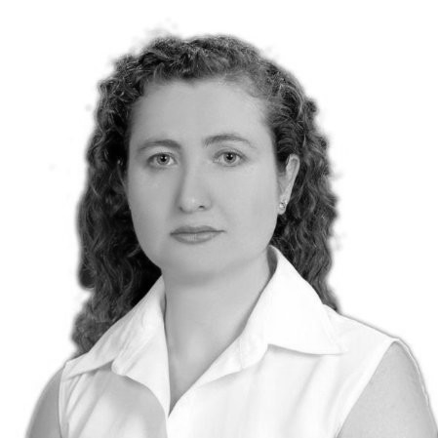
Contributors
MLA Harvard University
BSc New York State University
Founder of AirCar
Co-founder of Outliers Notebook
Co-founder of Nabu Technology
BA Marmara University
Partner of Aircar
CEO and Co-founder of Nabu Tech.
Eray
Founder
Ayhan
Partner
Mert
Design Engineer
Volkan
Mechanical Engineer
Yener
Airbus Pilot
Berin
Industrial Engineer
Ali
Mechanical Engineer
Ece
Finance Consultant

